Slide 1
Secure data hiding in images using steganography
CAPSTONE PROJECT
Presented By: Vedant Panjab Jamodkar
Student Name : Vedant Panjab Jamodkar
College Name & Department : Modern Education Society’s Wadia College of Engineering
Third Year B.E. Computer Engineering

Slide 2
OUTLINE
Problem Statement
Technology used
Wow factor
End users
Result
Conclusion
Git-hub Link
Future scope

Slide 3
Problem Statement
In today’s digital age, securing sensitive information is a major challenge.
Traditional methods of encryption are often detectable, making them vulnerable to attacks.
There is a need for a secure and discreet way to hide messages within everyday files, such as images, without raising suspicion.
Objective: Develop a tool that allows users to securely hide and retrieve messages within images using steganography, ensuring confidentiality and integrity.

Slide 4
Technology used
Backend: Python with Flask for server-side logic and routing.
Image Processing: OpenCV for manipulating pixel values to hide and retrieve messages.
Frontend: HTML, CSS, and JavaScript for creating an interactive and user-friendly web interface.
Deployment: Local server using Flask for testing and demonstration purposes.
Libraries:
cv2 for image processing.
os for file handling.
Flask for web application development.

Slide 5
Wow factors
Discreet Communication: Messages are hidden within images, making them undetectable to the naked eye.
Double Security: Combines steganography with a passcode for an additional layer of protection.
User-Friendly Interface: Simple and intuitive web interface for seamless encryption and decryption.
Customizable: Users can specify the length of the hidden message during decryption.
Cross-Platform: Works on any device with a web browser, making it accessible to a wide audience.

Slide 6
End users
Individuals: For personal use to securely share confidential information (e.g., passwords, private messages).
Businesses: To protect sensitive data during communication (e.g., sharing proprietary information).
Journalists and Activists: For secure communication in regions with strict surveillance.
Educators and Students: To demonstrate steganography concepts in cybersecurity courses.
Cybersecurity Enthusiasts: For experimenting with data hiding techniques

Slide 7
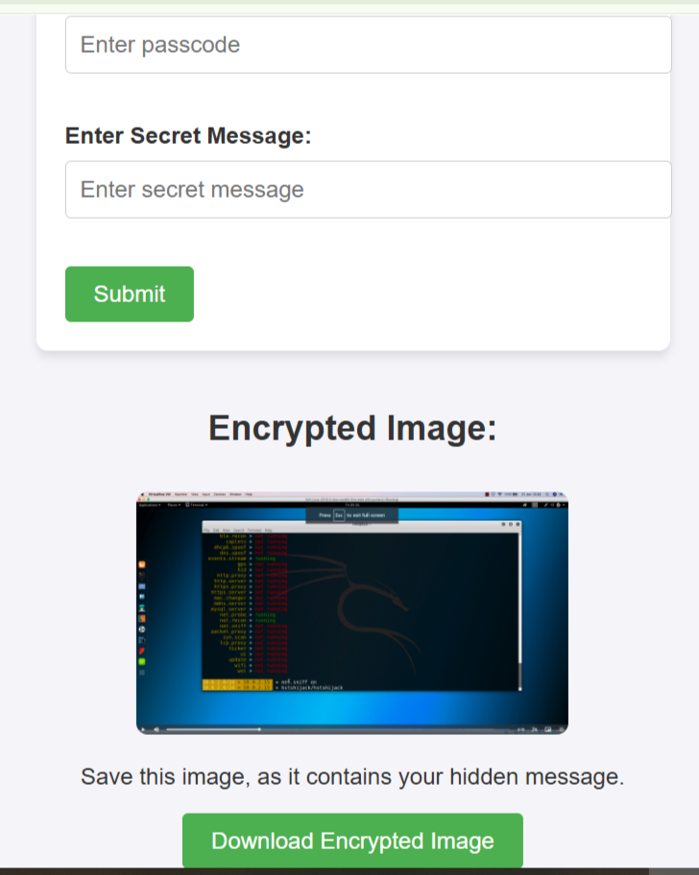
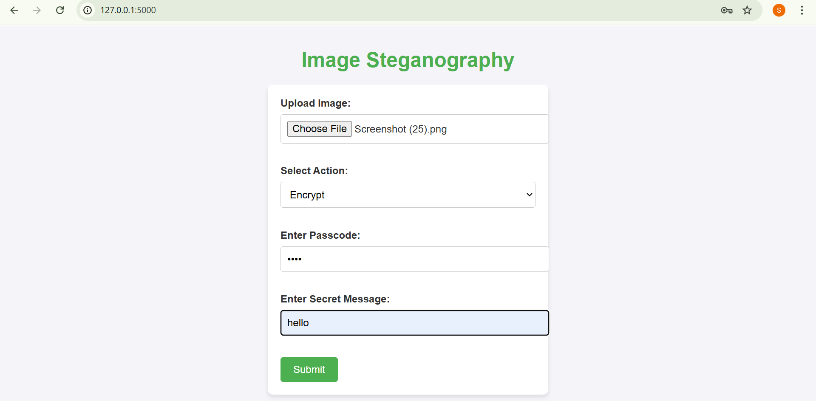
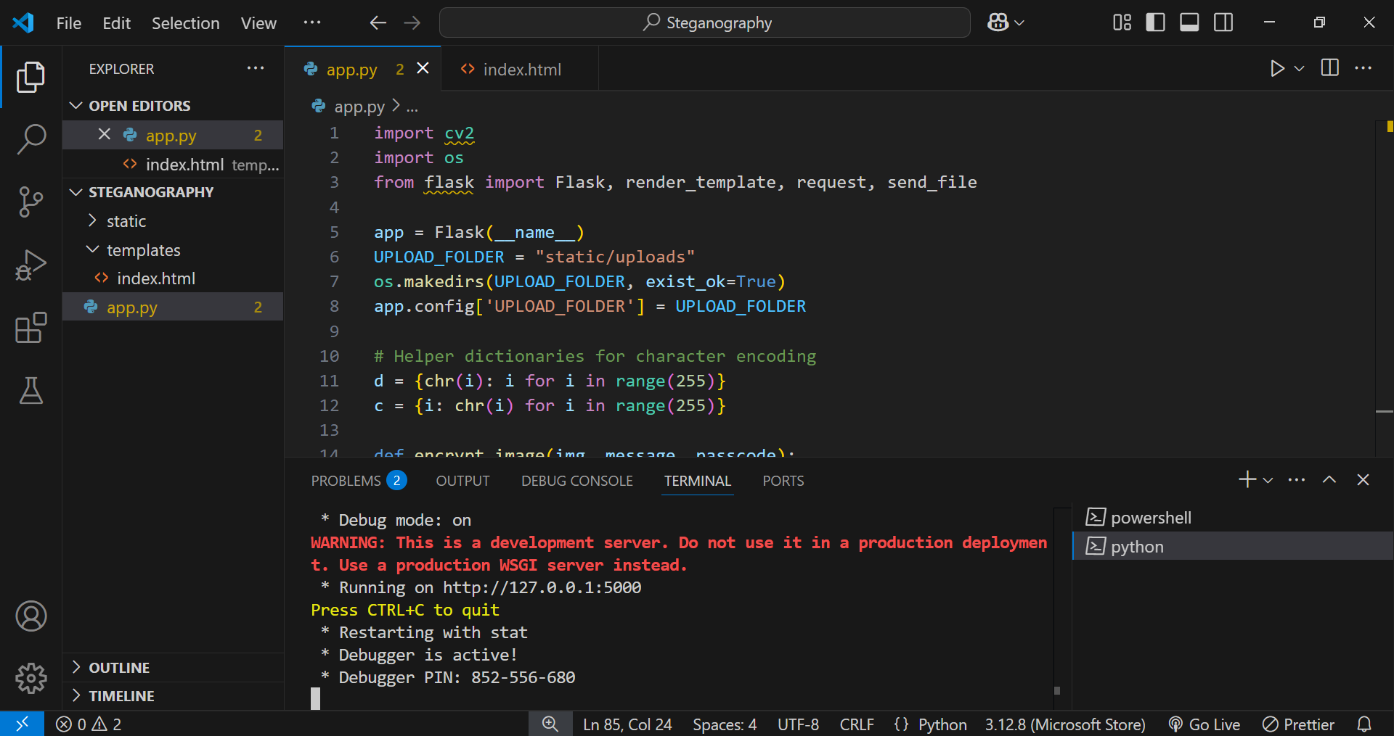
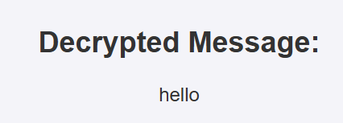
Results

Slide 8
Conclusion
The Image Steganography Tool provides a secure and efficient way to hide messages within images.
It addresses the growing need for discreet communication in a digital world.
The combination of steganography and passcode-based security ensures robust protection against unauthorized access.
The project demonstrates the practical application of image processing and web development in cybersecurity.

Slide 9
GitHub Link
https://github.com/VedantJamodkar/Steganography

Slide 10
Future scope
Enhanced Security: Implement advanced encryption algorithms (e.g., AES) for added security.
Support for Other File Types: Extend the tool to hide messages in audio, video, and other file formats.
Cloud Integration: Allow users to upload and process images directly from cloud storage (e.g., Google Drive, Dropbox).
Mobile App: Develop a mobile version for on-the-go usage.
Machine Learning: Use AI to detect and prevent tampering with steganographic images.
User Authentication: Add user accounts and authentication for personalized usage.
Open Source Community: Encourage contributions to improve and expand the tool’s capabilities.

Slide 11
THANK YOU

